Slide 1
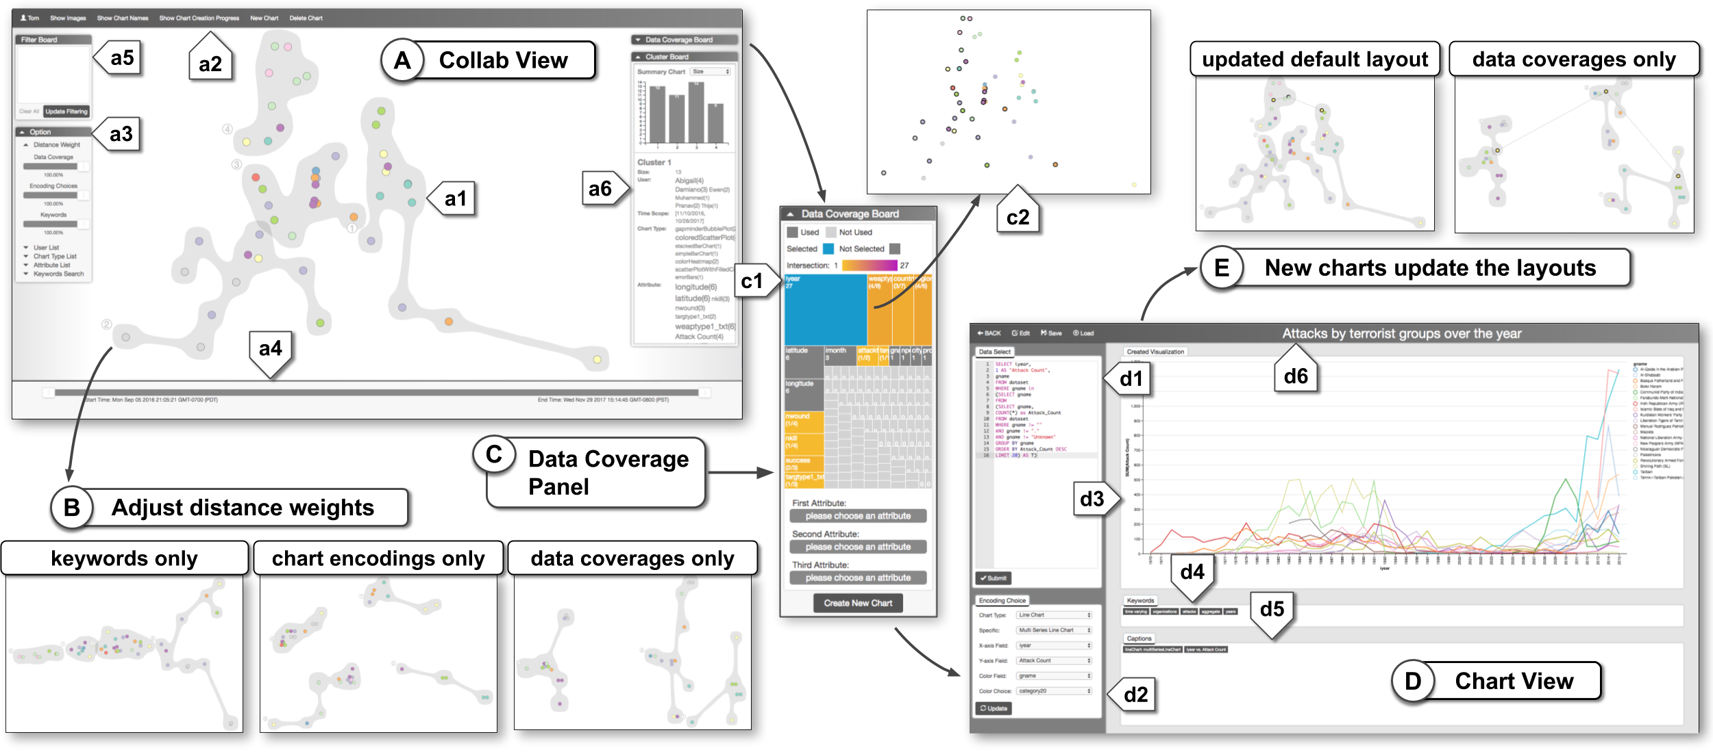
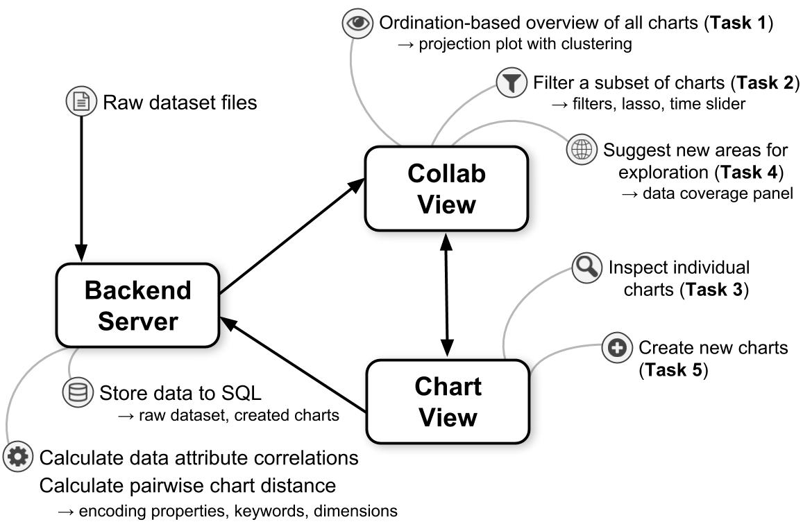
PEARL : An Interactive Visual Analytic tool for Understanding
Personal Emotion Style from Twitter
Introduction
The PEARL system is an interactive timeline based visual analytic tool which allows users to view examine a person’s emotional style derived from his tweets. .
Interactions in various trending topics will have influence of User Emotional State.
Twitter is one the best social share our ideas over trending topics.
This is a visual analytic tool that provides the Users emotional state over a period of time.
System Description
Stacked Area chart shows the combined emotion analysis over a time series data. -> Color encodes different emotions of Plutchik Model.
-> Area of each emotion depends on the valence score.
Area chart that displays number of tweets per day the user has posted.
Scatter Plot that displays the important words and its VAD scores that says the particular emotion of the tweet.
Word cloud is used to find significant words from the tweets.
Raw tweet view shows the tweets and the significant words to detect the emotion in bold characters. This bold words and its VAD scores are used for Scatter Pie Plot.
Extension : We built a RNN based approach to detect the tweet emotions. Multi line chart is used to display 8 different emotions from the Plutchik Model.
Backend:
NRC emotion lexicon is a list of English words has 10 basic emotion values and their VAD scores.
Datasets:
Our Data set consists of political leader twitter handles like Narendra Modi, Donald Trump, Barack Obama.
We used Tweepy and Twitter web scrolling to get the tweets of this twitter handles.
Results:
Can present a case study here.
Show how to analyze dataset using the system, including the new capabilities provided by the extension.
Make sure the narrative flow makes sense to people not familiar with your project!
expedita distinctio.
[authors]
[ email addresses]

